Slide 1


CREDIT CARD FRUAD DETECTION
By:-
RA1911003010361
Alla Rohith Reddy
RA1911003010373
Krishna Prabeesh Kakarla
RA1911003010378
K. Purna Chandra Kishore
RA1911003010368
Parth

Slide 2

ABSTRACT
Due to cashless transaction everyone uses debit cards and credit cards for transaction , leading to the increase of credit and debit card frauds.
loss in Billions of dollars are caused every year by fraudulent credit card transactions. The design of efficient fraud detection algorithms rely on advanced machine learning techniques to assist fraud investigators.

Slide 3
INTRODUCTION
Online shopping is growing day by day. For purchasing goods and services with the help of virtual cards are used in online transactions and physical card for offline transactions.
In physical-card based purchase, the cardholder presents his card physically to a merchant for making a payment , if the cardholder does not realize the loss of card, it can lead to substantial financial loss to the credit card company. In online payment mode, attackers need only little information for doing fraudulent transaction (secure code, card number, expiration date etc.)

Slide 4
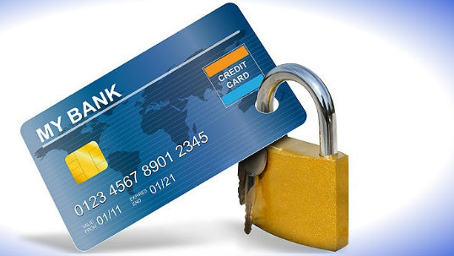
PROBLEM STATEMENT
Credit card fraud stands as a major problem for worldwide financial institutions. Annual loss due to it scales to billions of dollars.
We can observe this from many financial reports. Such as 10th annual online fraud report by Cyber Source , shows that estimated loss due to online fraud is $4 billion for 2008 which is 11% increase than $3.6 billion loss in 2007 and in 2006 .
fraud in United Kingdom alone was to be £535 million in 2007 and now costing around 13.9 billion a year

Slide 5

FRAUD DETECTION
Fraud detection is process of identifying fraudulent transaction .
It is a topic which is applicable to many industries including banking and financial sectors, insurances, government agencies, and law enforcement and many more . Through the use of sophisticated data mining tools, millions of transactions can be searched to spot patterns and detect fraudulent transaction.
Credit card fraud detection technique is used to recognize fraudulent credit card transactions so that customers are not charged for items that they did not purchase.

Slide 6
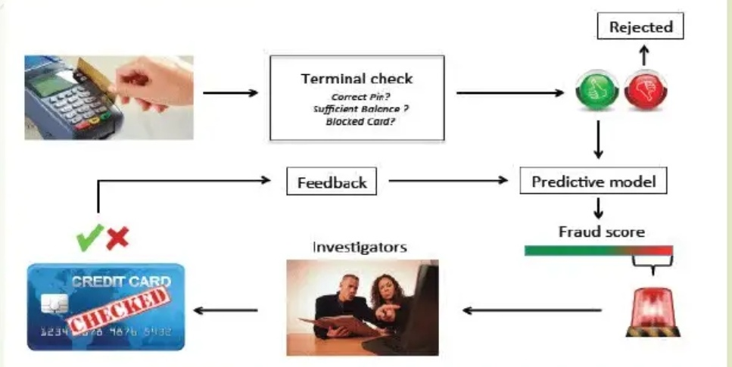
FRAUD DETECTION PROCESS

Slide 7

TECHNOLIGIES USED...
Machine Learning
Machine learning is the scientific study of algorithms and static models that computer system use in order to perform a specific task effectively without using the explicit instruction, relaying on patterns and interface instead.
Machine learning algorithms build a mathematical model based on sample data, known as training data in order to make prediction and decisions.
Machine learning algorithms are used in email filtering, face recognition, etc.

Slide 8
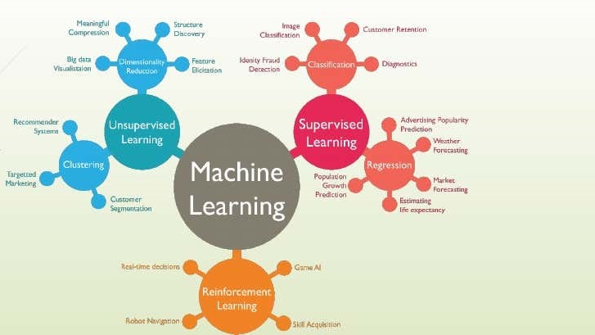

Slide 9

SUPERVISED LEARNING
Supervised learning as the name indicates the presence of a supervisor as a teacher.
Supervised learning algorithm build a mathematical model of a set of data that contain both input and output.
Basically supervised learning is a learning in which we teach or train the machine using data which is well labeled that means some data is already tagged with the correct answer
After that, the machine is provided with a new set of example
(data) so that supervised learning algorithm analyses a correct
outcome from labeled data.

Slide 10
UNSUPERVISED LEARNING
Unsupervised learning is the training of machine using information that is neither classified nor labelled and allowing the algorithm to act on that information without guidance.
Here the task of machine is to group unsorted information according to similarities, patterns and differences without any prior training of data.
Unlike supervised learning, no teacher is provided that means no training will be given to the machine. Therefore machine is restricted to find the hidden structure in unlabelled data by our self.

Slide 11

ALGORITHM USED...
Logistic regression...
Logistic regression is a statistical model that in its basic form uses a logistic function to model a binary dependent variable, although many more complex extension exist. In regression analysis , logit regression(a.k.a Logistic Regression) is , estimating the parameters of a logistic model (a form of binary regression). Mathematically, a binary logistic model has a dependent variable with two possible values.

Slide 12
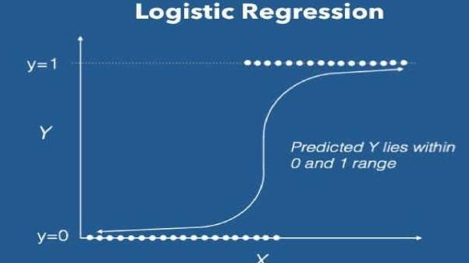

Slide 13

FETCHING DATASET
The Dataset that is used for credit card fraud detection is derived from the Kaggle.
Kaggle is the online community of data scientist and Machine learners.
Kaggle allows users to find and publish data sets, explore and build models in a web-based data science project and solve challenges.

Slide 14

ADVANTAGES OF LOGISTIC REGRESSION
The results obtained by the Logistic Regression algorithm obtains better results compared to any other Algorithms.
The Accuracy obtained was almost equal to cent percent which proves using of Logistic algorithm gives best results.

Slide 15

SYSTEM REQUIREMENTS
Hardware Requirements:
RAM: 4GB and Higher
Processor: Intel i3 and above
Hard Disk: 500GB Minimum
Software Requirements:
OS : windows or Linux
Python IDE: python 2.7.x and above or Jupyter Notebook .
Setup tools and pip to be installed for 3,6 and above. Language Python

Slide 16
CONCLUSION AND FUTURE SCOPE
Fraud Detection system have become essential for banks and financial institution, to minimize their losses.
However, there is a lack of published literature on credit card fraud detection techniques, due to the unavailable credit card transaction dataset for researches .
We designed a system to detect fraud in credit card transaction. This system is capable of providing most of the essential features required to detect fraudulent and legitimate transactions.
The dataset available on the day to day processing may become outdated, it is necessary to have updated data for effective fraud behaviour identification.

Slide 17
REFERENCES
Aggarwal, Charu c. "Outlier analysis." Data mining, Springer International Publishing, 2015.
Salazar, Addisson, et al. "Automatic credit card fraud detection based on non-linear signal processing." Securit Technology (ICCST), 2012 IEE.
Aurelien Geron's, "Hands-on Machine Learning with Scikit-Learn, Keras and TensorFlow", Shroff'O'Reilly, 2019.
Gupta, S.C. "Fundamental of Statistics". Himalya Publishing Housing, 2018. THE GUEST

Slide 18




THANK YOU
STAY HOME STAY SAFE

